Slide 1
GCAM Overview
Marshall Wise, Gokul Iyer, Neal Graham
2024 GCAM Annual Meeting: Training Sessions
On Behalf of the PNNL GCAM Team
Notes:
Stock Image

Slide 2
Session Outline
GCAM (Global Change Analysis Model) Basics
Coverage, Modeling Approach, Uses and Interpretation
GCAM Energy Sectors
GCAM Agriculture and Land Use Sectors
GCAM Water Sectors

Slide 3
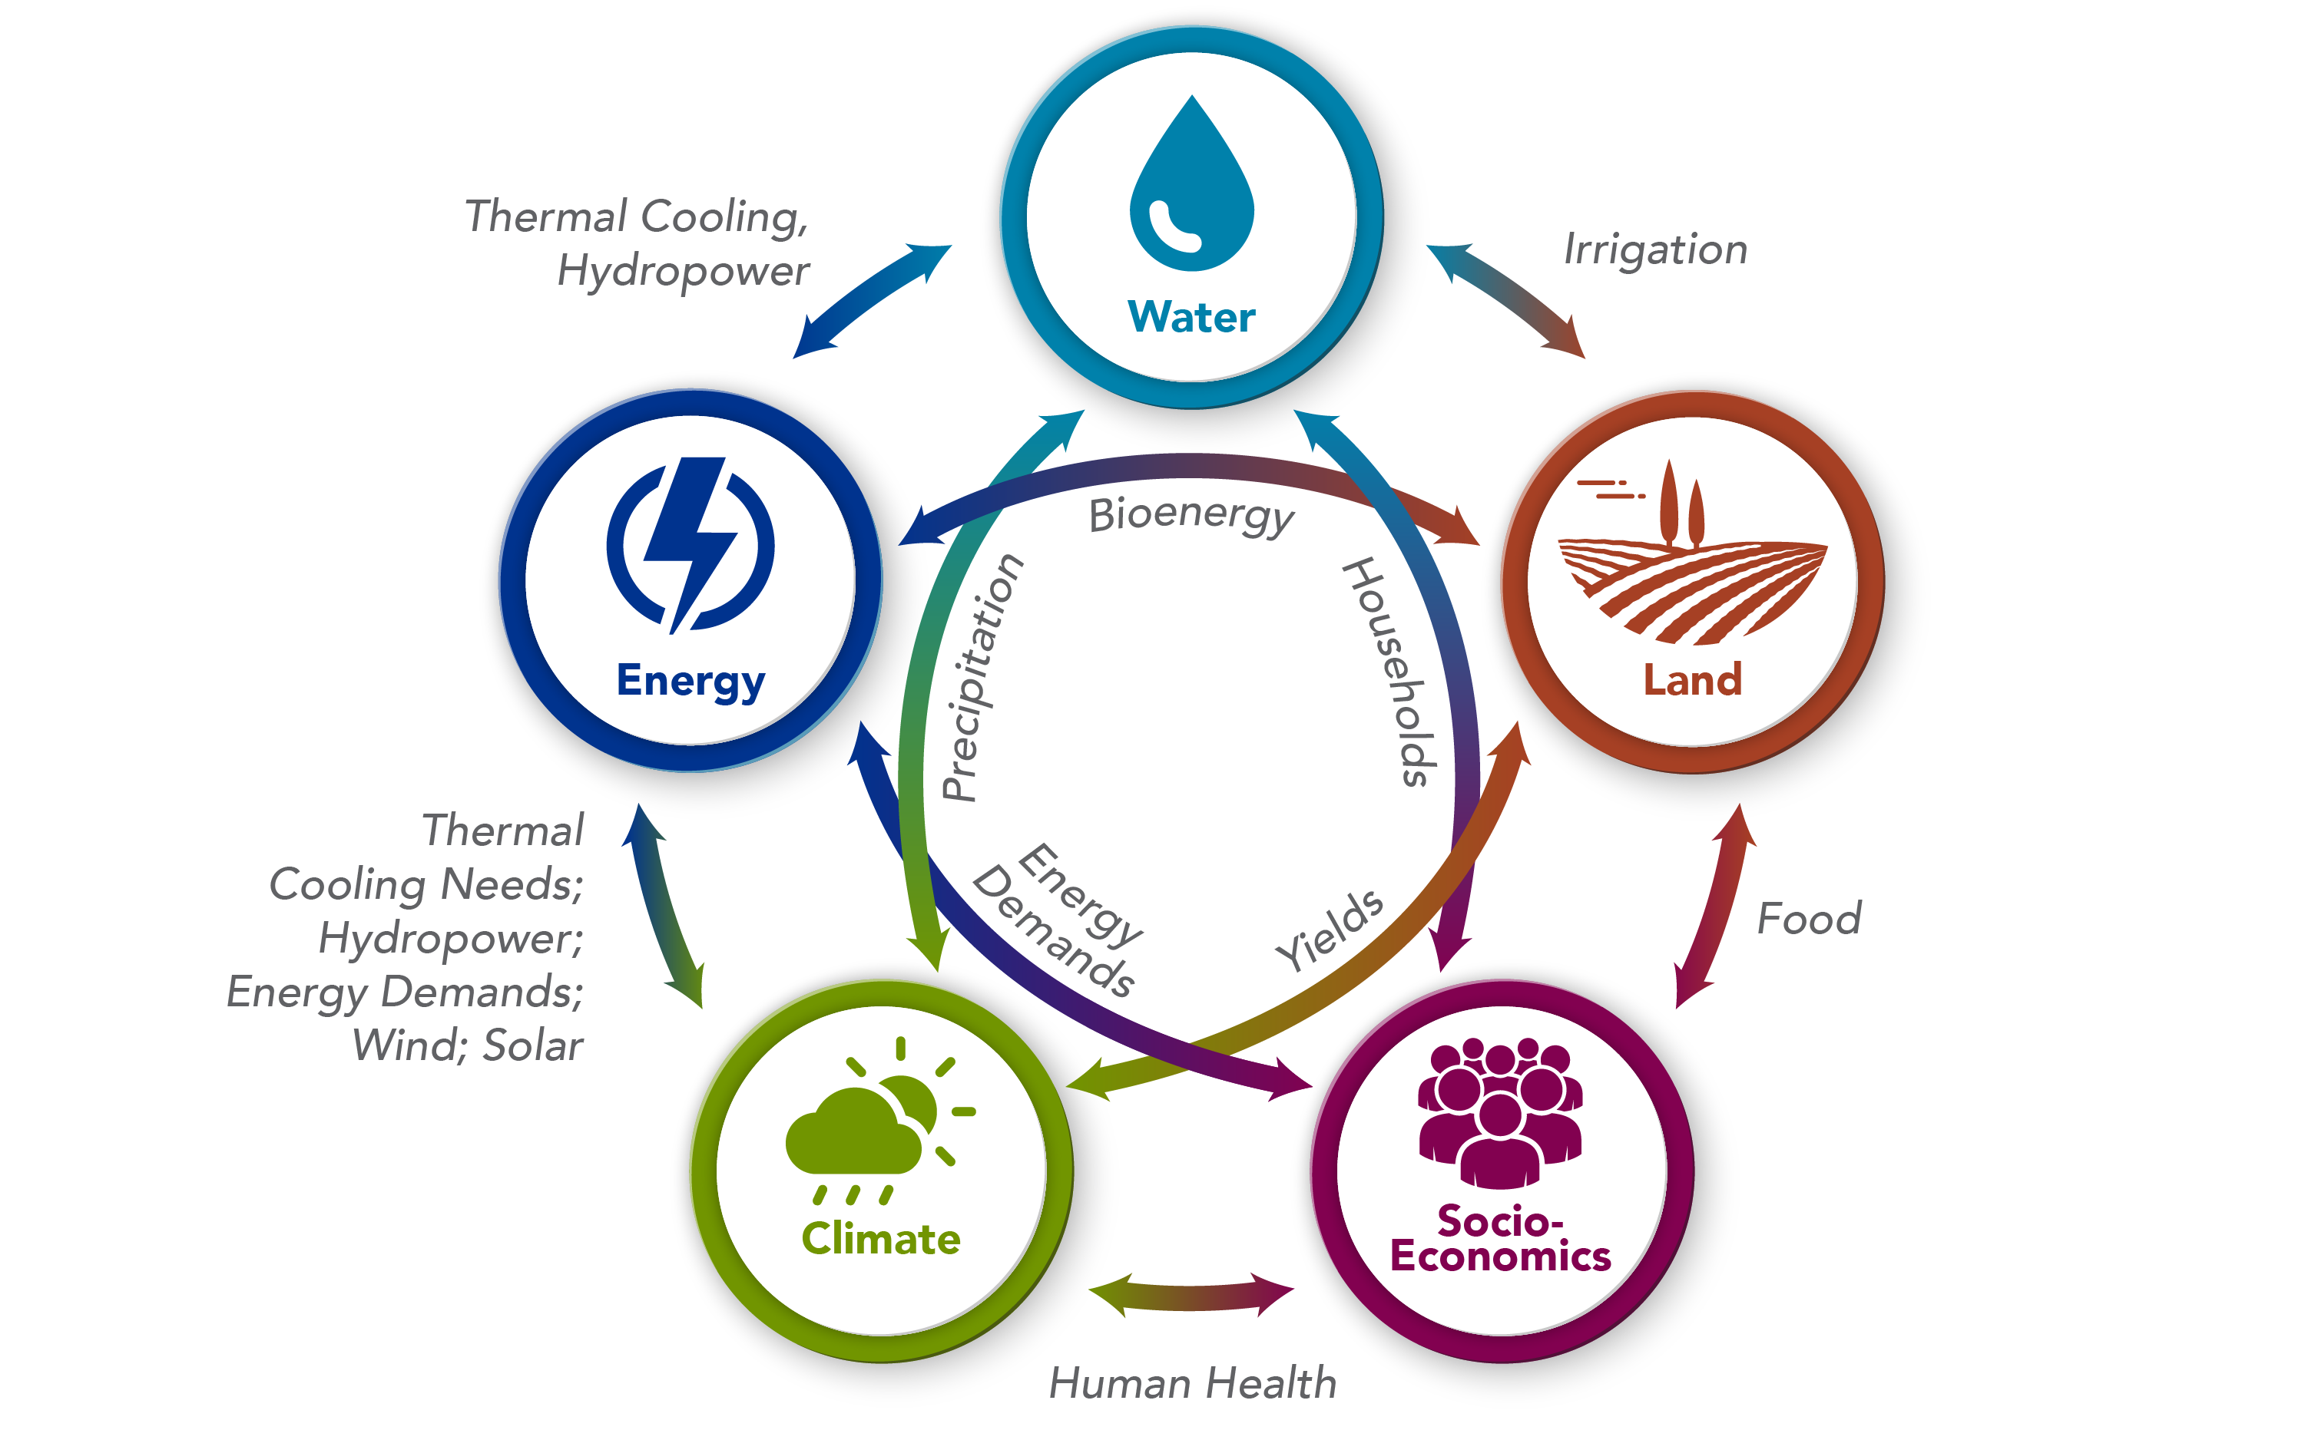
GCAM explores the interactions among multiple human and Earth systems
GCAM economically and physically links long-term (to year 2100) Energy, Agriculture, Land, Water, and CO2 and other GHG Emissions and air pollutants.
GCAM incorporates PNNL’s Hector climate model for computation of atmospheric concentrations and climate results.

Slide 4
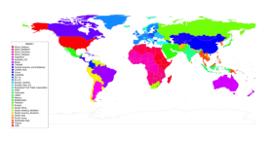

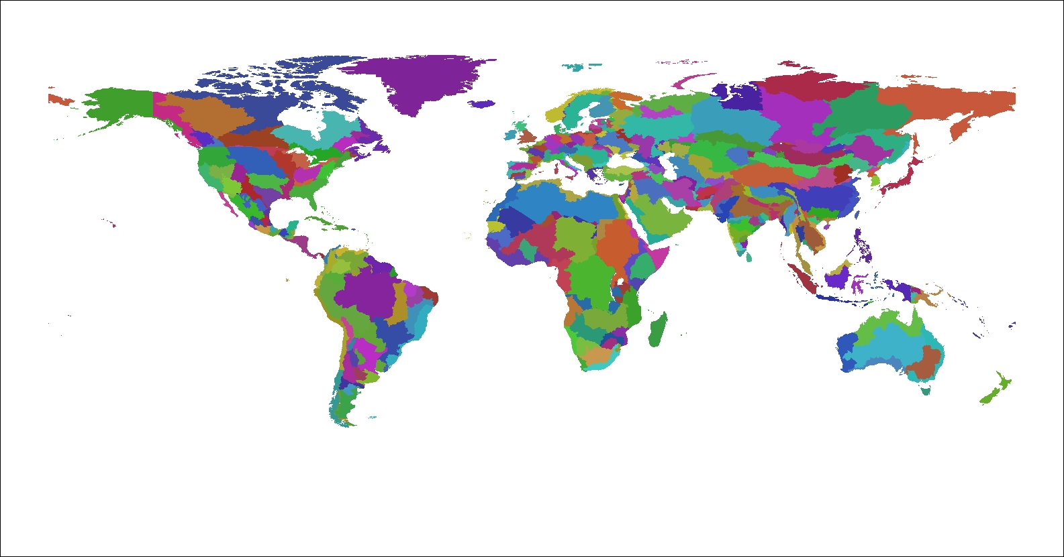
GCAM Scope and Coverage
Global Coverage
GCAM is a multisector, multi-regional, dynamic model that economically and physically links energy, agriculture and water production, consumption, and trade.
GCAM models dynamic demand growth in response to regional population and economic activity.
GCAM includes technology detail in energy production, transformation and final demand sectors.
GCAM includes physical representations of crop management practices in the agriculture sector.
Includes all commercial and natural lands in each land region.
GCAM includes dynamic economic modeling of the water sector linked to energy and agriculture.
GCAM computes a detailed accounting of emissions of CO₂ and other important gases.
32 Energy & Economy Regions
235 Water Basins
384 Land Regions
32 Energy/Economic regions
384 Land regions based on water basins
GCAM-USA (50 State)

Slide 5
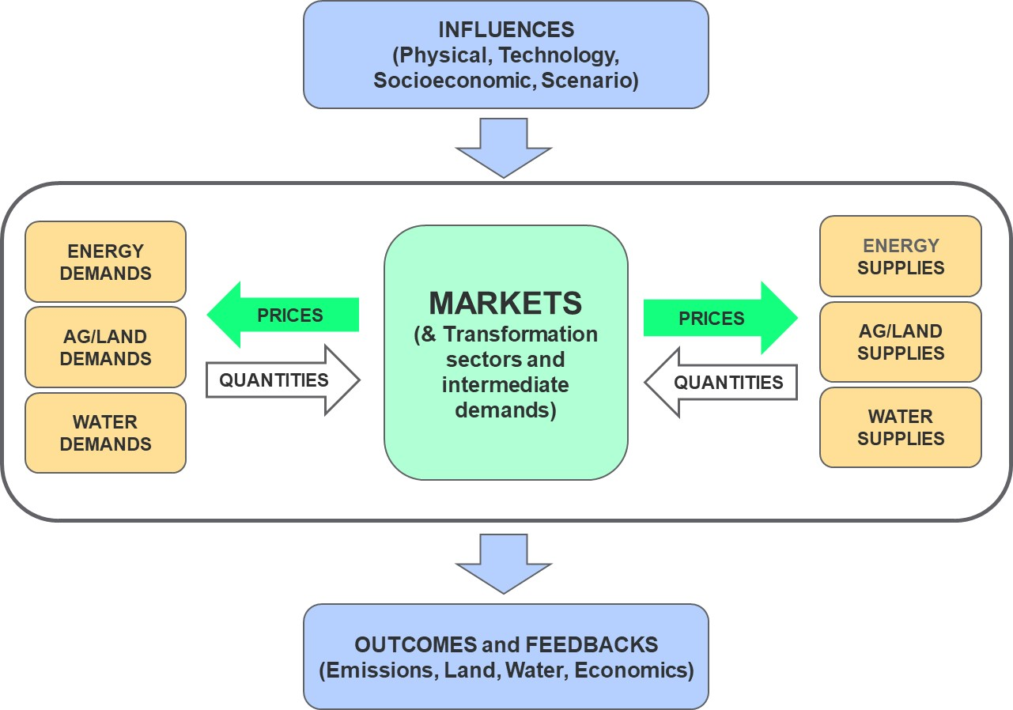
GCAM Modeling Approach: Economic Equilibrium with Physical Detail
GCAM solves each future period by finding the set of prices so that all modeled markets are “cleared.”
GCAM uses a recursive dynamic rather than an intertemporal optimal approach.
GCAM’s non-linear system of equations is solved by finding the set of prices so that all supplies equal all demands.
Economic equilibrium in GCAM means that physical quantities of the sectors it covers are balanced and allocated economically efficiently.
Prices are the signals by which the multiple sectors communicate scarcity and demands and dynamically respond to each other.

Slide 6
Logit Choice Mechanism for Economic Decisions
Logit approach assumes a distribution of realized costs/profits due to heterogeneous conditions.
Market share based on probability that a technology has the least cost.
Non-linear technology competition
Historical calibration influences future competition through the “share-weight” (α)
Exponent reflects a non-constant elasticity term
In general, GCAM production functions, supplies and demands, and markets are non-linear.
Increasing marginal costs.
Diminishing returns to scale.
Linear constraints are not needed to bound solution.
6

Slide 7
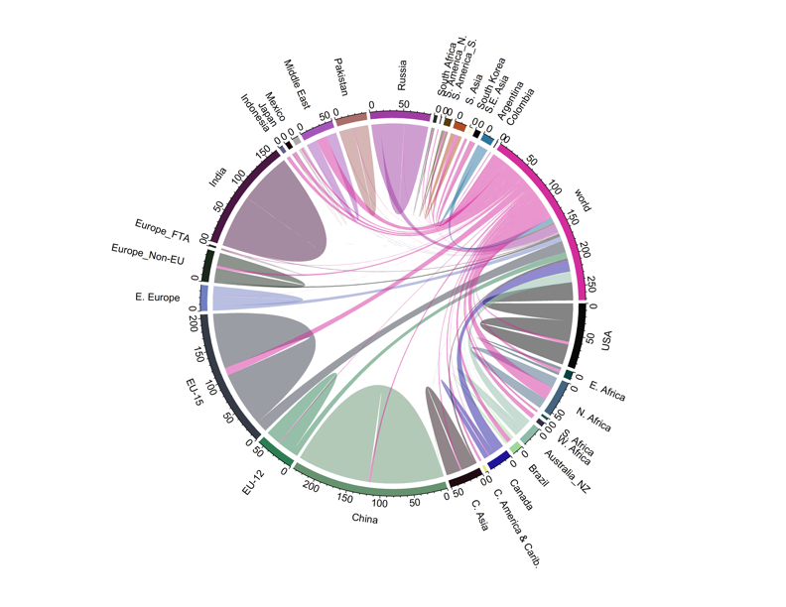
Regional Teleconnections and Economic Trade
Wheat in GCAM: Regional Markets with Global Trade
Trade and teleconnections are key to understanding dynamic impacts and outcomes: globally and in the US.
Critical to several research areas:
Trade in energy and important minerals,
Regional energy and food prices/access,
Regional resilience/impacts of climate.
GCAM now has trade capabilities on par with prominent trade models.
GCAM can parameterize the full range from simple global trade, detailed bilateral trade, regional trading blocs, to Zero trade.
Imports from World
Exports to World
Demand
Production

Slide 8
GCAM Results are a function of scenario input assumptions
Modeled Scenario
Population
Labor Productivity
Scenario Assumptions
Technology Characteristics
Model Equations, Relationships, and Parameters
Population
Policies
Labor Productivity
Emissions
Technology Characteristics
Prices
Energy Supplies and Demands
Policies
Agricultural Production
Land Use
Concentrations and Temperature

Slide 9
GCAM Results are a function of scenario input assumptions
Design Philosophy – flexible, data-driven modeling so that the input assumptions and parameters are open to users and can generate very different scenario results.
This is an obvious goal probably shared by all such models, but it is worth noting.
Examples.
Based on varying assumptions about cost and resources for renewable, fossil, and nuclear power, generate very different scenarios of the future energy mix,
And see a very different energy mix in a scenario that assumes a transition to low-carbon energy.
To the extent possible, make important “constraints” and “drivers” based on user-controlled input assumptions rather than be subsumed into the model structure.
For example, assumptions about amount of land allowed for commercial expansion for agriculture and bioenergy production.
Or additional costs for integrating a higher share of variable renewable energy.
GCAM has an international user base and has been downloaded thousands of times.
GCAM has been used extensively by PNNL and collaborators in several countries such as India, Canada, China, Spain, Pakistan, and Colombia.

Slide 10
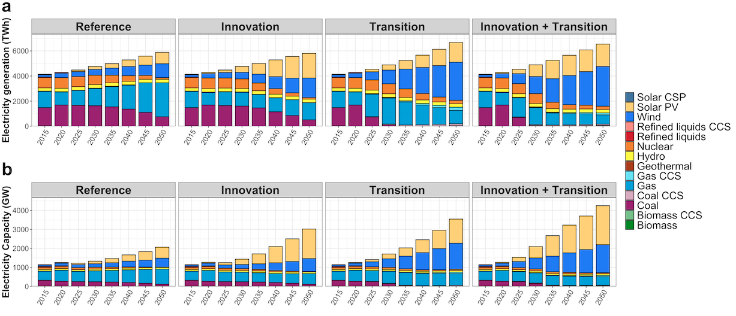
GCAM Modeling of Low-Carbon Scenarios
US generation and capacity mixes under technology and carbon transition scenario assumptions:
GCAM-USA capacity and dispatch modeling
GCAM solves for the economically efficient mix consistent with meeting a carbon or GHG scenario.
Dual interpretation of shadow prices and marginal emissions costs.
GCAM solves for these transition pathways consistently with all of the multi-sector scenario assumptions.
Ou Y., M.T. Binsted, G.C. Iyer, P.L. Patel, and M.A. Wise (2021). "US state-level capacity expansion pathways with improved modeling of the power sector dynamics within a multisector model." Energy Strategy Reviews 38. Nov 2021.

Slide 11
What’s inside the GCAM?

Slide 12
GCAM Energy Sector Modeling

Slide 13
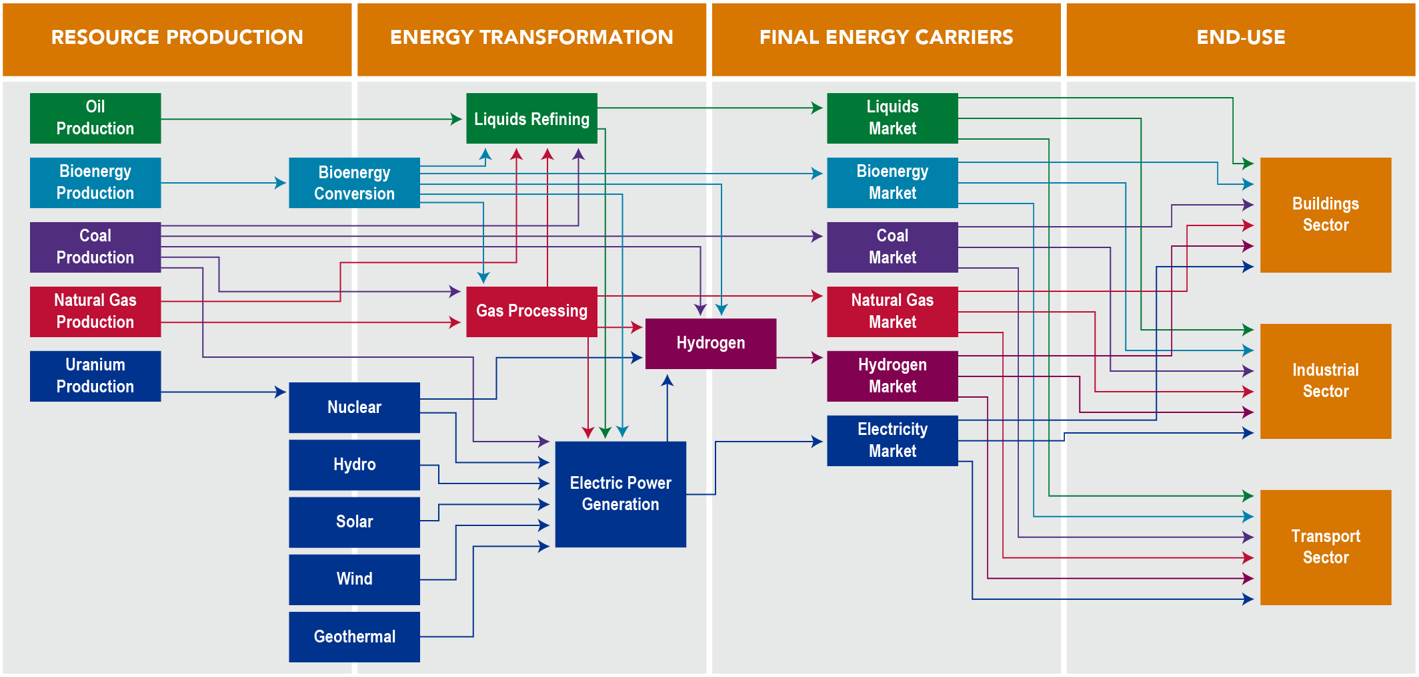
GCAM Energy System

Slide 14
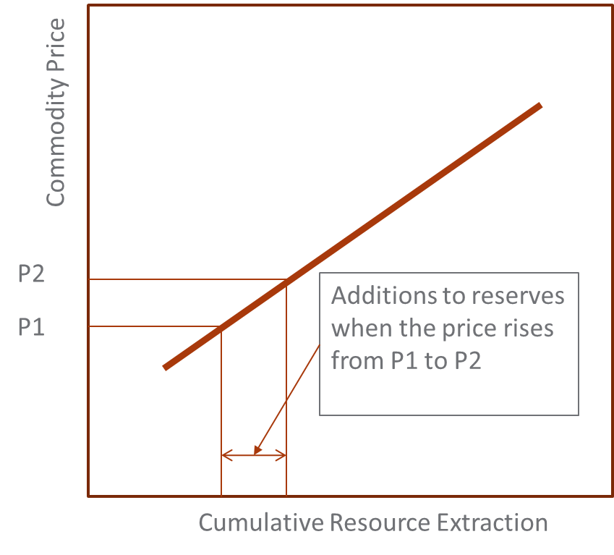
GCAM Fossil Resources: Resource-Reserve model
Production occurs out of reserves
Reserves are constantly being depleted and enhanced
Additions to reserves depends on the resource supply schedule
Resources are the ultimately available abundance in the Earth’s crust
GCAM assumes production of reserves to occur over a well / mine lifetime appropriate for each fuel
Technical change is applied to model decreasing extraction costs of the “resource” in future years

Slide 15
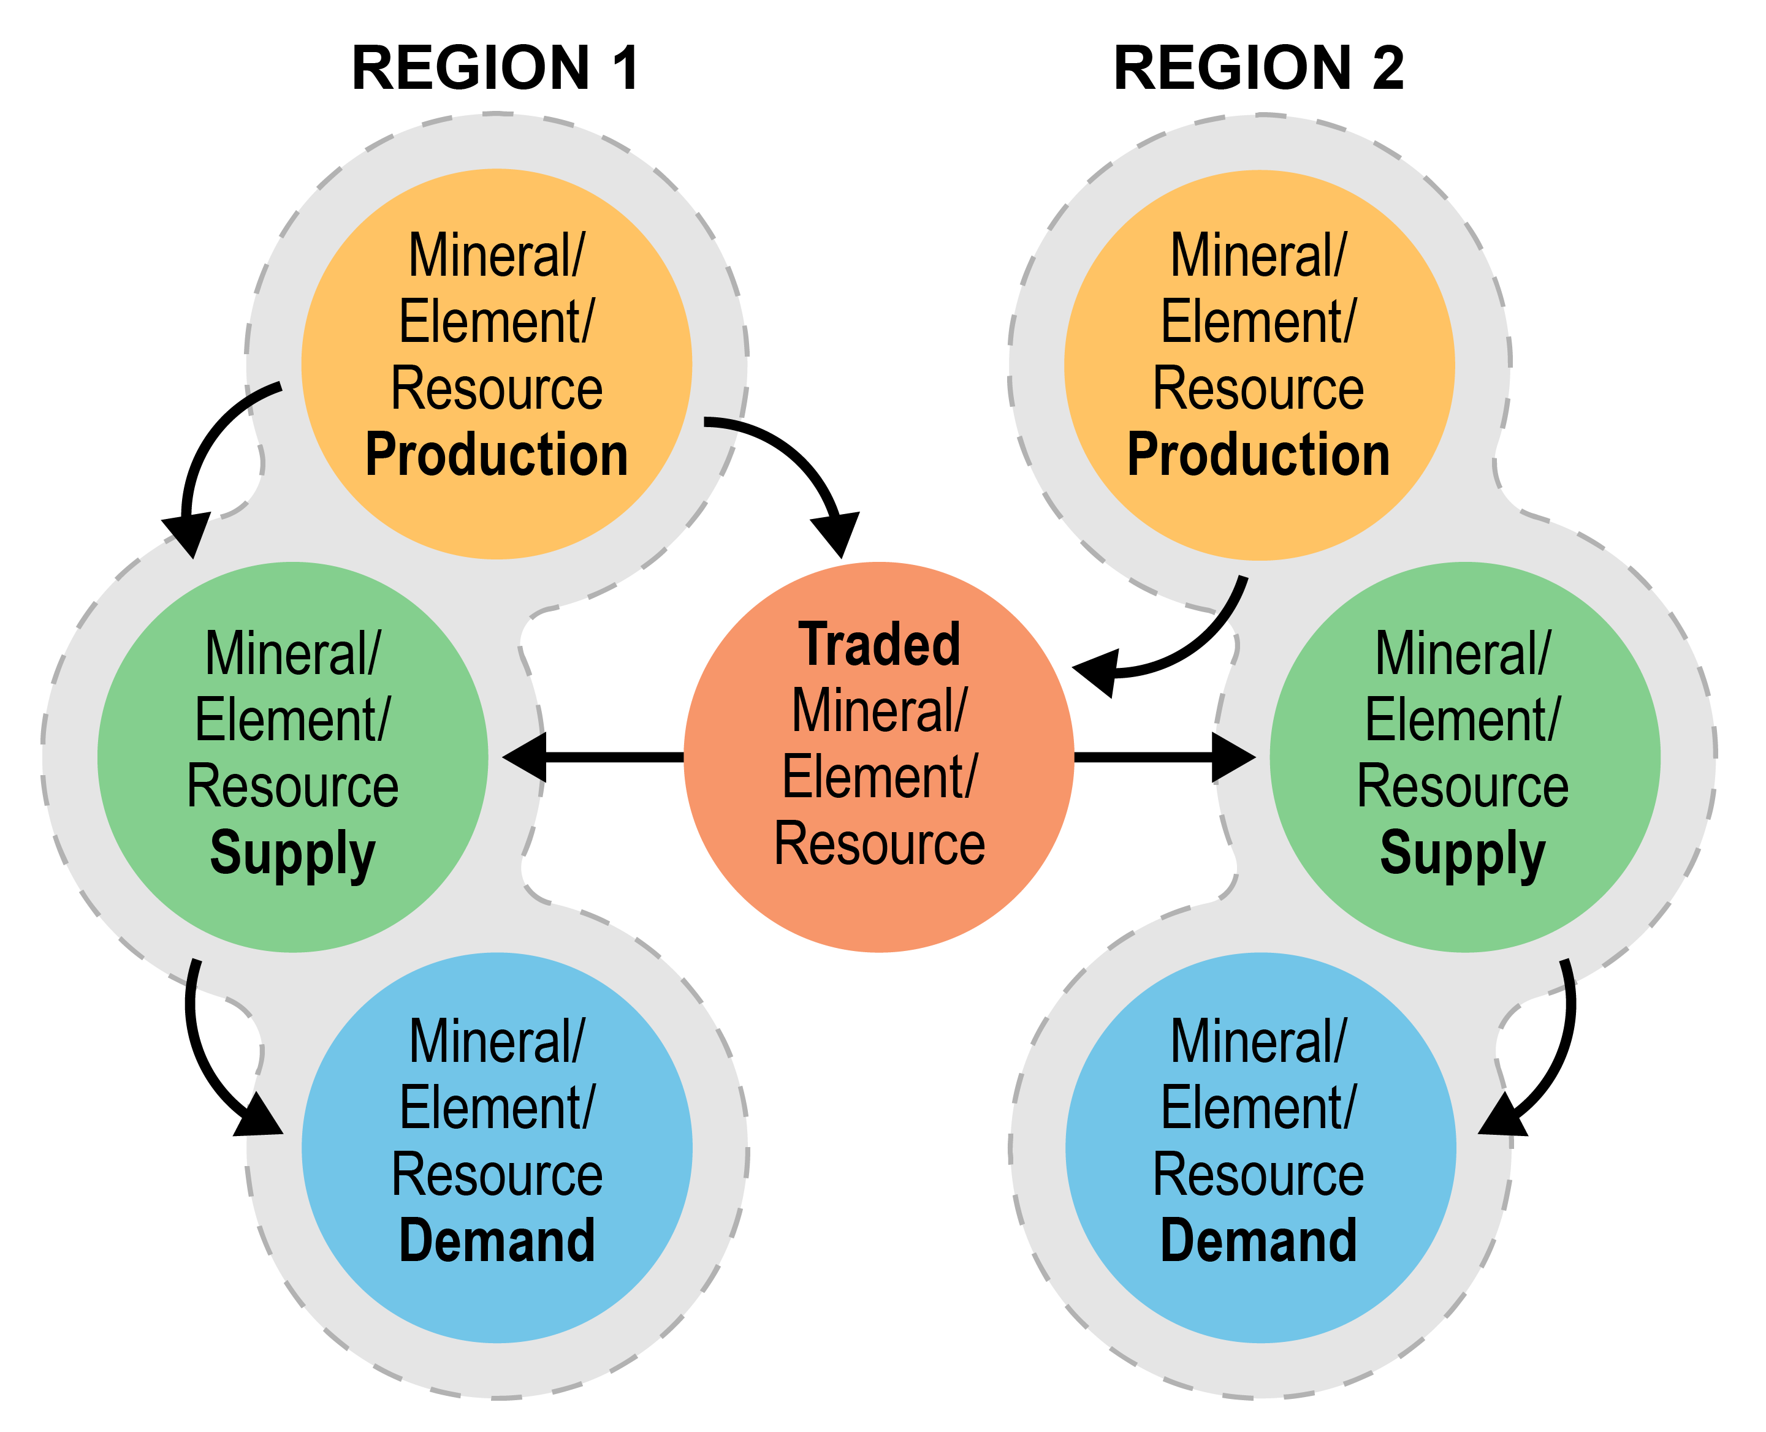
GCAM Modeling of fossil fuel trade
Previously, every region produced and consumed from a single global market.
All crude oil, coal, and natural gas production was sent to a shared market, from which, every region consumed.
Only net trade could be tracked and supply was affected by global rather than regional demand.
Our new Armington-based structure distinguishes between direct consumption of domestic resources and consumption of imported fossil fuels
Creates price-based competition between domestic and imported goods
Introduces realistic inertia in the evolution of trade from current patterns
Enables exploration of a wide range of trade scenarios
Introduces consistency in the modeling of trade across sectors and commodities in GCAM
Market structure for an example two-region trade market

Slide 16
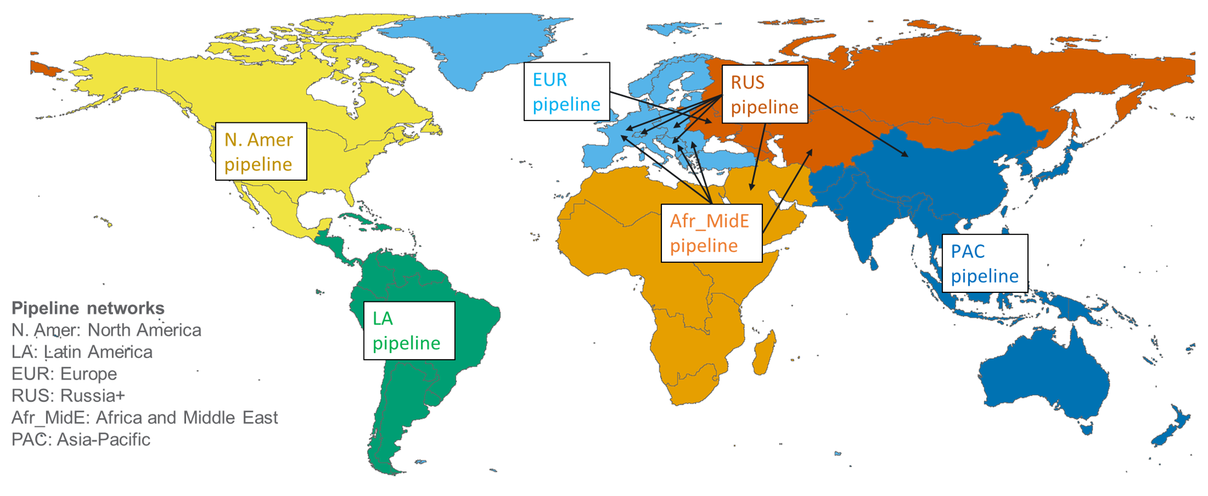
GCAM Natural Gas Pipeline and LNG Trade
Natural gas is traded via LNG (globally) and in 6 regional pipeline networks
Armington trade structure: gross exports and imports are distinguished
Other fossil fuels are traded globally using an Armington structure
Natural gas pipeline trade modeling in GCAM

Slide 17
GCAM Renewable Resources
GCAM’s renewable resources include onshore wind, offshore wind, solar, geothermal, hydropower, and biomass; some regions are also assigned a “traditional biomass” resource
Regional supply curves for onshore wind, offshore wind, and rooftop PV represent increasing costs as most efficient sites are used first
Solar PV and CSP are modeled as unlimited resources but include regional assumptions for capacity factors
Wind, PV, and CSP technologies include options with and without dedicated storage
The costs of producing electricity from renewable energy forms consist of the sum of resource costs described above, capital and O&M costs, and in some cases, intermittency costs

Slide 18
GCAM Renewable Intermittency
For each of the solar and wind technologies, GCAM includes, both a purely intermittent option and an option paired with dedicated storage
The representation of intermittency costs for intermittent renewable options without dedicated storage attempts to reflect the diminishing contributions to electric capacity reserves as the share of intermittent technologies in the grid increases
The marginal reserve capacity requirement is computed as an exponential function of the share of intermittent renewable capacity in total electric power capacity
The cost of reserve capacity requirements is calculated by assuming that the reserve capacity is provided by natural gas combustion turbines operating at a low capacity factor

Slide 19
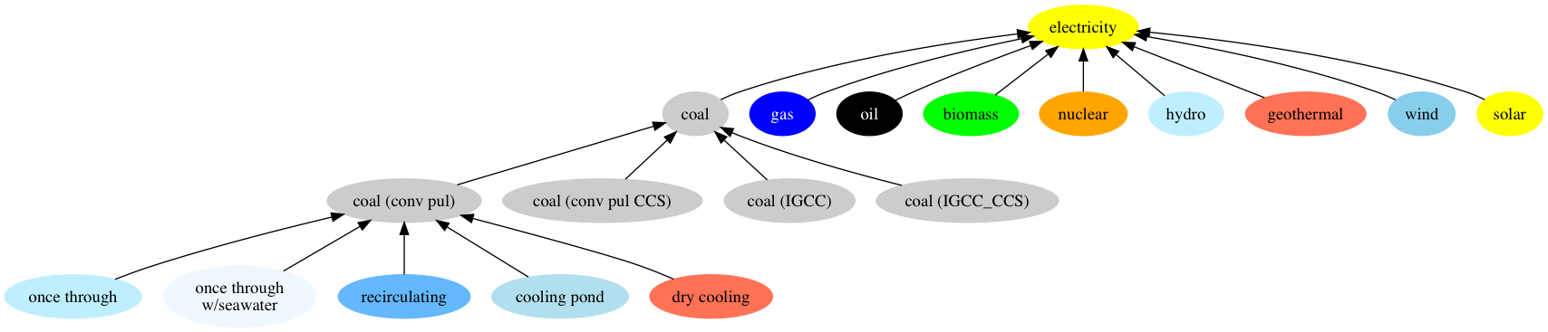
GCAM Electricity Generation
Power production depends on existing plants—run full lifetime as long as operating costs are covered
Natural and economic retirements are modeled
New capacity coming online is chosen based on levelized costs
Cost includes capital, fixed and variable O&M, resource/ fuel prices, and intermittency costs (for intermittent renewables w/o dedicated storage)
Multiple technology options, e.g. 4 types of coal plants, includes options w/ and w/o CCUS, different types of cooling systems

Slide 20
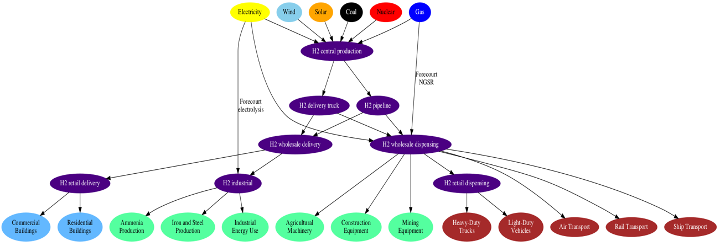
GCAM Hydrogen Production
GCAM includes endogenous representation of supply, distribution, and demand of hydrogen (H2)
H2 can be produced through 10 “central” production technologies, as well as 2 “forecourt” (i.e. on-site) production technologies
H2 production using coal, gas, and biomass include CCS options
Notes:
Overhaul the structural representation of distribution so as to better estimate the heterogeneous prices paid by various end-use purposes, which are largely a function of the temperatures and pressures at which hydrogen is transported and stored
Distinguish between pipeline-based distribution and liquid hydrogen truck-based distribution

Slide 21
GCAM Industrial Sector
GCAM Industry
Iron & Steel
Cement
Chemicals
Fertilizer
Aluminum
Construction
Mining
Energy Use
Agricultural Energy Use
Pulp and paper
Other industry includes machinery, textile and leather, other non-metallic minerals, and other non-ferrous metal.
Food processing
Other industry

Slide 22
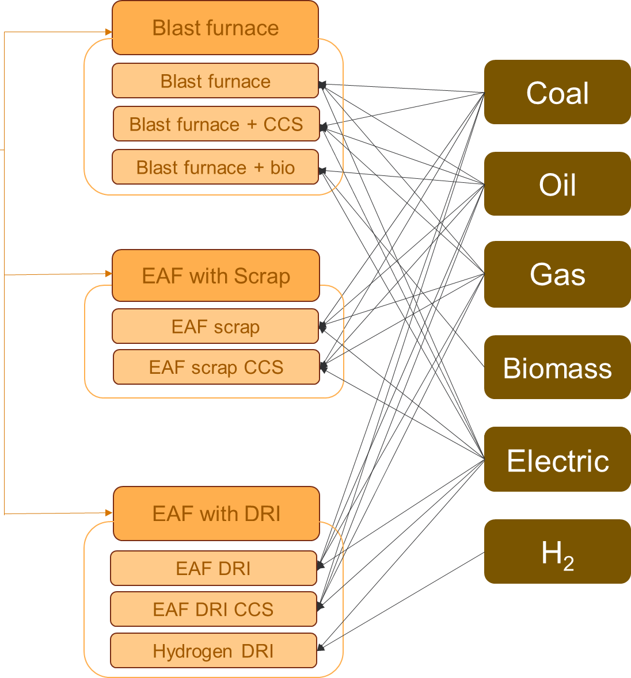
GCAM Iron and Steel Technologies
GCAM Industry
Iron & Steel
Cement
Chemicals
Fertilizer
Aluminum
Construction
Mining
Energy Use
Agricultural Energy Use
Pulp and paper
Food processing
Other industry

Slide 23
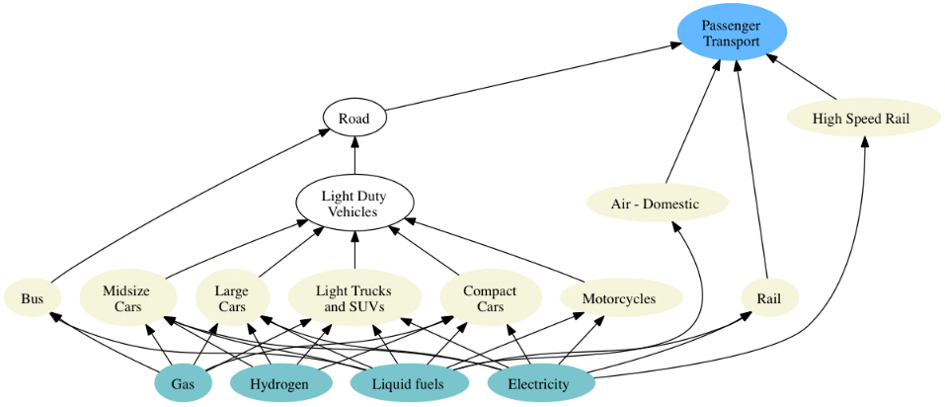
GCAM Transportation
The transportation sector in GCAM is subdivided into four final demands: long-distance passenger air travel, (other) passenger travel, international freight shipping, and (other) freight
The passenger sector includes competition across different modes (e.g., road, rail), sub-modes (e.g., bus, light duty vehicle), size classes, and drivetrain technologies
The choice among modes of transportation in the passenger sector is a function of the cost of travel, the time it takes, and income
The demand for transportation services (e.g., passenger-km, tonne-km) in region is a function of per-capita GDP, income elasticity, service price, price elasticity, and population growth

Slide 24
GCAM Buildings
GCAM disaggregates the building sector into residential and commercial sectors and models three aggregate services (heating, cooling, and other).
Within each region, each type of building and each service includes different mix of fuels supplying energy
Demand for energy and floorspace satiates as income increases
Satiation level of building energy service demand per unit floorspace is a function of HDD/CDD, building shell conductance, floor-to-surface ratio of buildings, and internal gain heat from other building services

Slide 25
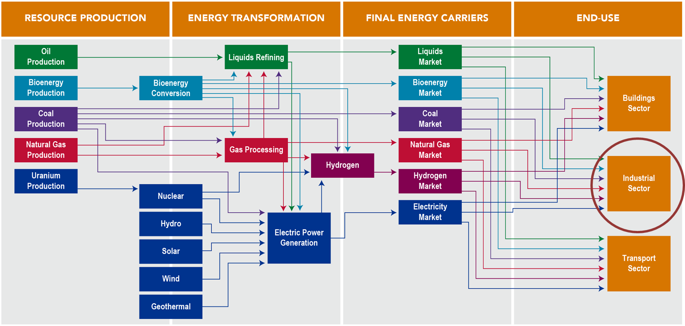
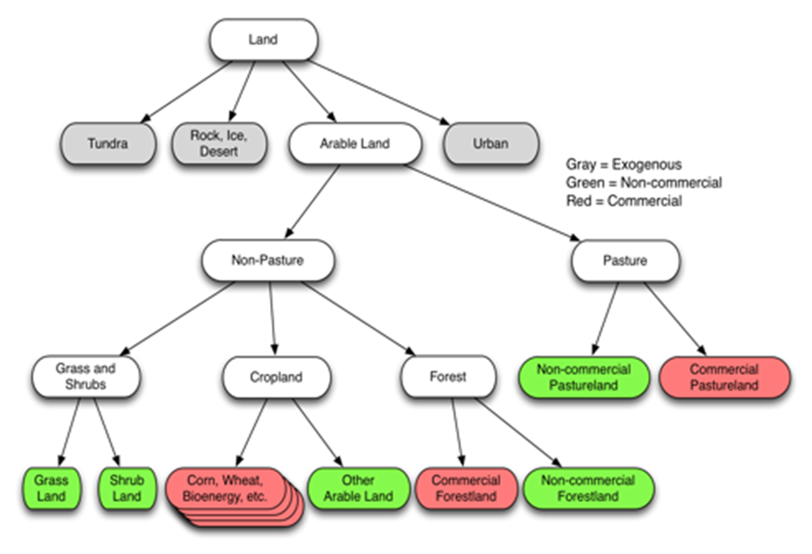
GCAM Industry
Agriculture-Land-Use
Energy
Energy and agriculture-land-use strongly interact.
Bioenergy
Pulp & Paper
Food Processing
Fertilizers

Slide 26
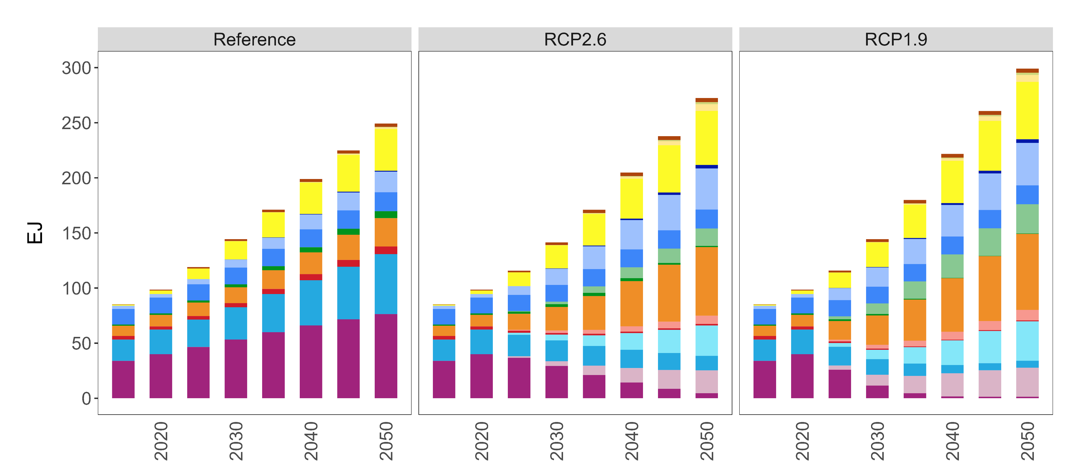
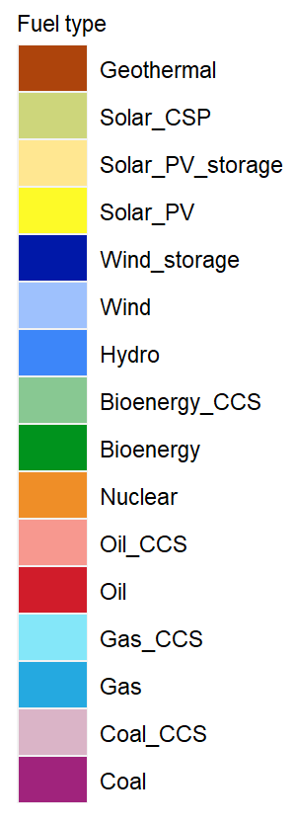
GCAM example results from Reference, RCP 2.6. RCP 1.9: Electricity Generation

Slide 27
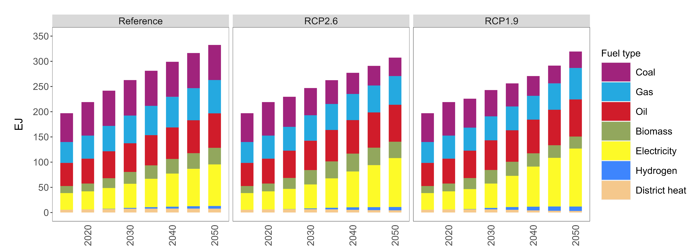
GCAM example results from Reference, RCP 2.6. RCP 1.9: Industrial final energy

Slide 28
GCAM Agriculture and Land Use Modeling

Slide 29
GCAM Land Use Regions
GCAM has 384 land use regions, formed by the intersection of geopolitical regions and water basins.

Slide 30

GCAM Land Use Categories (within each land use region)
All land cover and use, including all commercial land uses as well as non-commercial natural lands, are represented in GCAM.
These land categories are represented in each of the 384 land regions (where applicable) and calibrated to match a historical base year.
Economics drive future changes in cropland, pasture, forest, and other land uses.

Slide 31
GCAM Ag/Forest/Land Modeling: Inputs and Outputs
Inputs
Outputs
Harvested area in historic period
Land cover in historic period
Production in historic period
Consumption in historic period
Cost of production
Fertilizer application rates
Water coefficients
Carbon density, mature age
Emissions factors
Income elasticity of demand
Price elasticity of demand
Technical change
Logit parameters
FAO bilateral trade matrix
GCAM
Production
Consumption
International Trade
Land use, land cover
Yield
Crop Prices
Fertilizer use
Water withdrawals
Water consumption
Land use change emissions
Other land emissions
Historic calibration data
History + Future
Future driver data

Slide 32
Economic Competition for Irrigation and Intensification
For each crop, we have competing practices, each with a different yield, cost, and base year allocation. (hi = higher tech)
Changes in price or cost will alter the shares of each practice, enabling price-induced intensification.
Irrigated production demands and pays for water linked to GCAM water supply modeling in each region
Corn
Irrigated
Rainfed
Corn_IRR_Hi
Corn_IRR_
Lo
Corn_RFD_Hi
Corn_RFD_
Lo

Slide 33
Agricultural Demand
GCAM currently models supply and demand for approx. 13 crops, 6 animal categories, bioenergy, as well as wood products from forests.
We account for both food and non-food demand, including animal feed.
Demand for a given commodity changes over time in response to income, its price, and the price of substitutes.
Food, feed, and energy uses of crops are price responsive, but the price elasticity of demand for food crops is relatively small.
Demand is modeled at the 32 region level. Market Producer Prices differ in each of the 32 regions.
Regional Consumer prices are based on mix of consumption of local production and imports

Slide 34
The Agricultural System: Calibration
As with all GCAM sectors and activities, GCAM functions in the agriculture and land use system are calibrated to historical values.
We define a Base Year (with some averaging over a time period) for calibration, solve the modeling in calibration mode, and then the model reproduces that Base Year exactly.
Base Year calibration determines parameters which are then used to inform the model equations for investment and operation decisions in future model years.
Regional crop and forest production, demand, land allocation, irrigation water, fertilizer demand, gross crop and forest product imports and gross exports, as well as other inter-industry demands and technology choices are all calibrated.

Slide 35
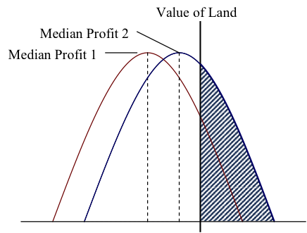
The Agricultural System: Land Competition
Logit shares based on relative profitability or value among competing uses of land.
Natural Land is also given an economic value (inferred from the data and calibration).
Non-linear – diminishing returns/increasing costs to expanding any one land use.

Slide 36
Land Competition and Logit Exponents
Higher exponent approaches linear or winner-take-all outcome.
Zero exponent means share is insensitive to profit changes.
Elasticity interpretation, although non-constant.
Source: Clarke and Edmonds (1993), McFadden (1974)
Land shares when land type 1’s profit increases by 20%

Slide 37
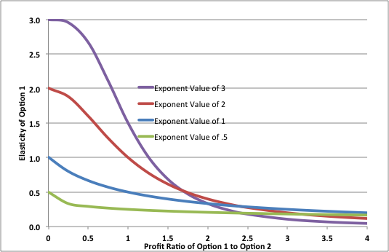
Logit Exponents and Elasticities
There is not a constant elasticity relationship with respect to changes in relative profit.
Elasticity is highest at low shares (profits), but decreases as share (profit) increases, reflecting diminishing returns to expansion.

Slide 38
Land Use Change and Terrestrial Carbon
GCAM tracks separate pools of vegetative and soil carbon for each land use and category in each land use region.
Changes in terrestrial carbon, whether a net emission or net uptake, occur when land is changed to a use with a different carbon density.
We start with the total change in carbon stock for each land type and region based on long-run carbon densities associated with each land use.
Δ C Stock = [Land Area (t)]*[C density (t)] - [Land Area (t-1)]*[C density (t-1)]
If change in land area decreases the vegetative carbon stock (e.g., deforestation), then GCAM computes a carbon emission in that period.
If change in land area increases the vegetative carbon stock (e.g., afforestation), then GCAM computes a gradual uptake over terrestrial carbon as the stock grows.
All changes in soil carbon, whether increasing or decreasing, are modeled over time assuming an exponentially rate to reach the long-run carbon density.

Slide 39
Other Agricultural Emissions
Base year emissions are calibrated to match the EDGAR data set for most emissions (exceptions are BC & OC, where we still use RCP inventories). We use this data to calculate emissions factors (emissions per unit of activity) for all crops and animals, as well as some land sources (savannah burning, deforestation, forest fires)
Emissions include: CH4, N2O, NOx, SO2, VOCs, NH3
Future emissions:
Increase if drivers increase
Decrease if abatement options are available and a carbon price is imposed. We use the new EPA MAC curves in this case.

Slide 40
Land Protection and Valuing Terrestrial Carbon
Land Protection: An amount of natural land is defined as not available for commercial uses such as food, fiber, bioenergy, or forest for wood production, or commercial pasture.
Currently in GCAM Core, each land region has protected lands based on existing protection laws, as implemented in PNNL’s Moirai model.
The amount of protected land varies by region, but globally is about 30% average.
This is much lower than the 90% protection we have assumed in many previous GCAM studies.
Valuing Terrestrial Carbon: When implemented, GCAM places a value on carbon in the terrestrial system proportional and consistent with the value of carbon emissions reduction in the energy sectors.
This method results in land use decisions that are economically-efficient with the energy system in terms of carbon emissions trade-offs.

Slide 41
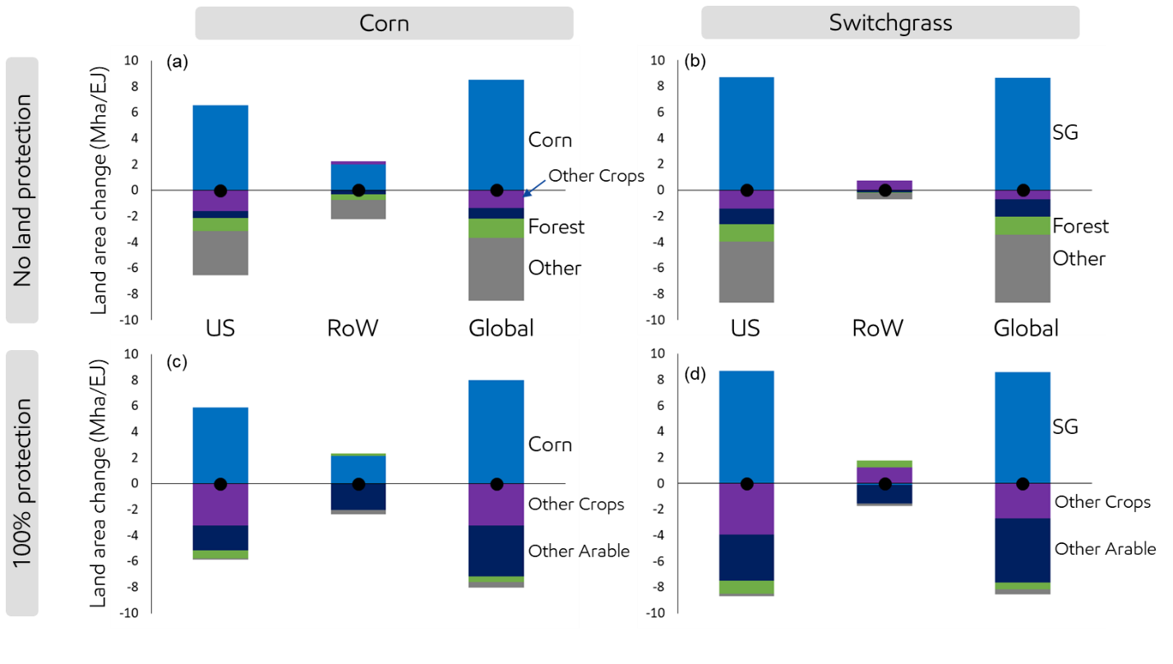
Importance of Land Availability/Protection Assumptions
LUC per Marginal Unit of US Ethanol
The assumption that natural lands are not available for cropland expansion (100% protection case) has a significant impact.
Corn ethanol/no protection, land for additional corn comes from other (e.g. pasture) and some forest, in addition to land for other crops.
For corn ethanol and 100% protection, more of that land displaces other crops and other arable land (unused cropland).
With important impact on the LUC emissions implications.
Mignone, Bryan K., Jonathan E. Huster, Sarah Torkamani, Patrick O’Rourke, and Marshall Wise (2022). “Changes in global land use and CO2 emissions from US bioethanol production: Sensitivity to crop type and natural lands protection.” Climate Change Economics. 2022.

Slide 42
GCAM Water Sector Modeling

Slide 43
What’s inside the GCAM?

Slide 44
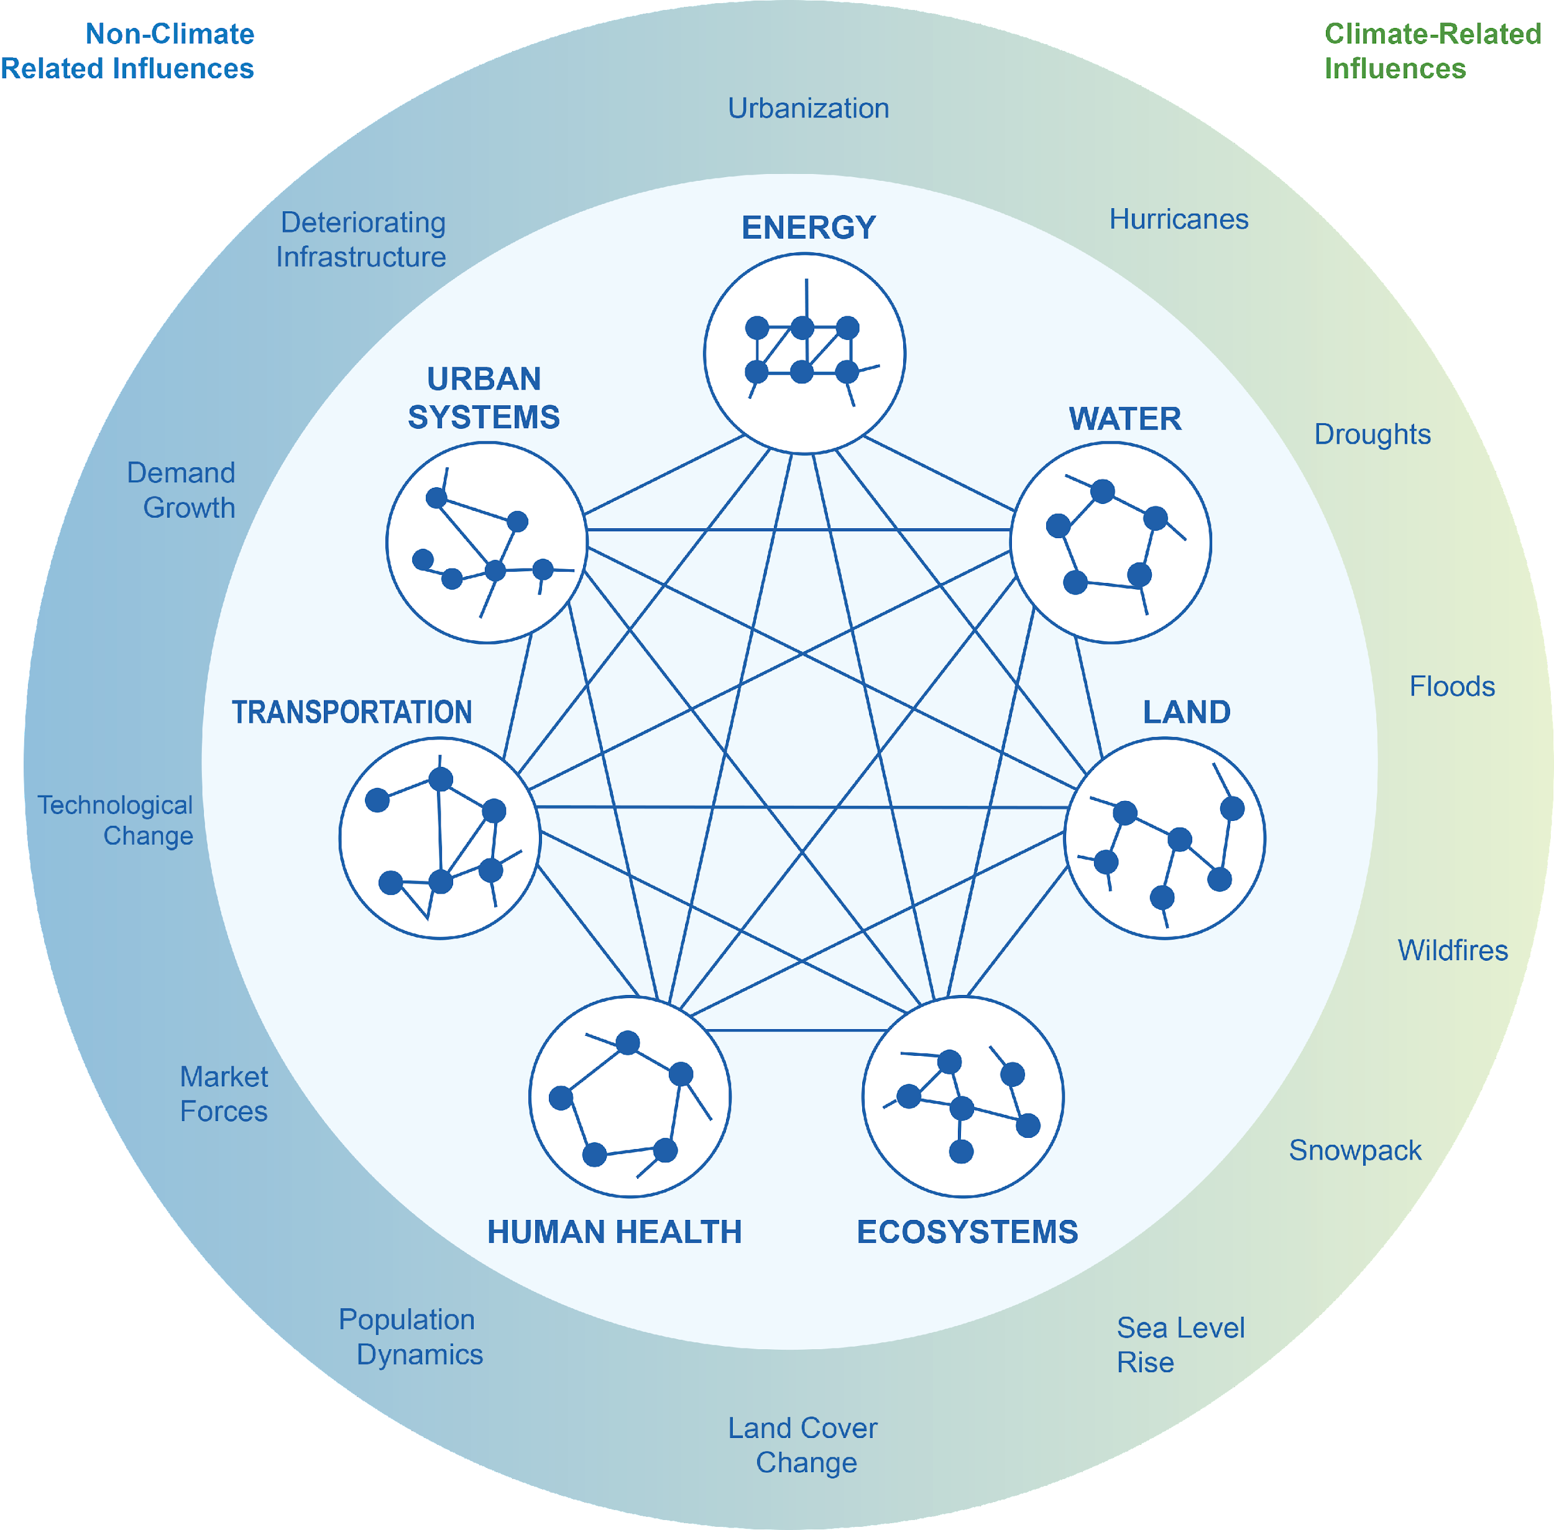
Why Include Water and Some Examples
Energy, water, land and other system elements are highly interconnected
Humans produce more emissions, which alter climate, resulting in altered water availability and increasing energy system requirements
Population grows, demanding more energy, land for food, and water for the food and energy
Source: Clarke et al. (2018)

Slide 45
Water Supply in GCAM

Slide 46
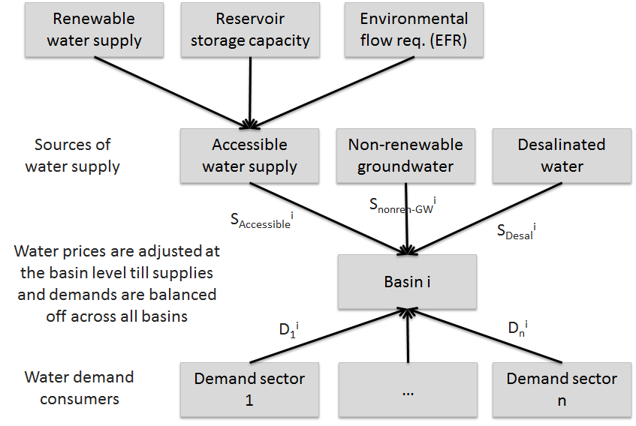
Basin-scale Water Allocation Mechanism in GCAM

Slide 47
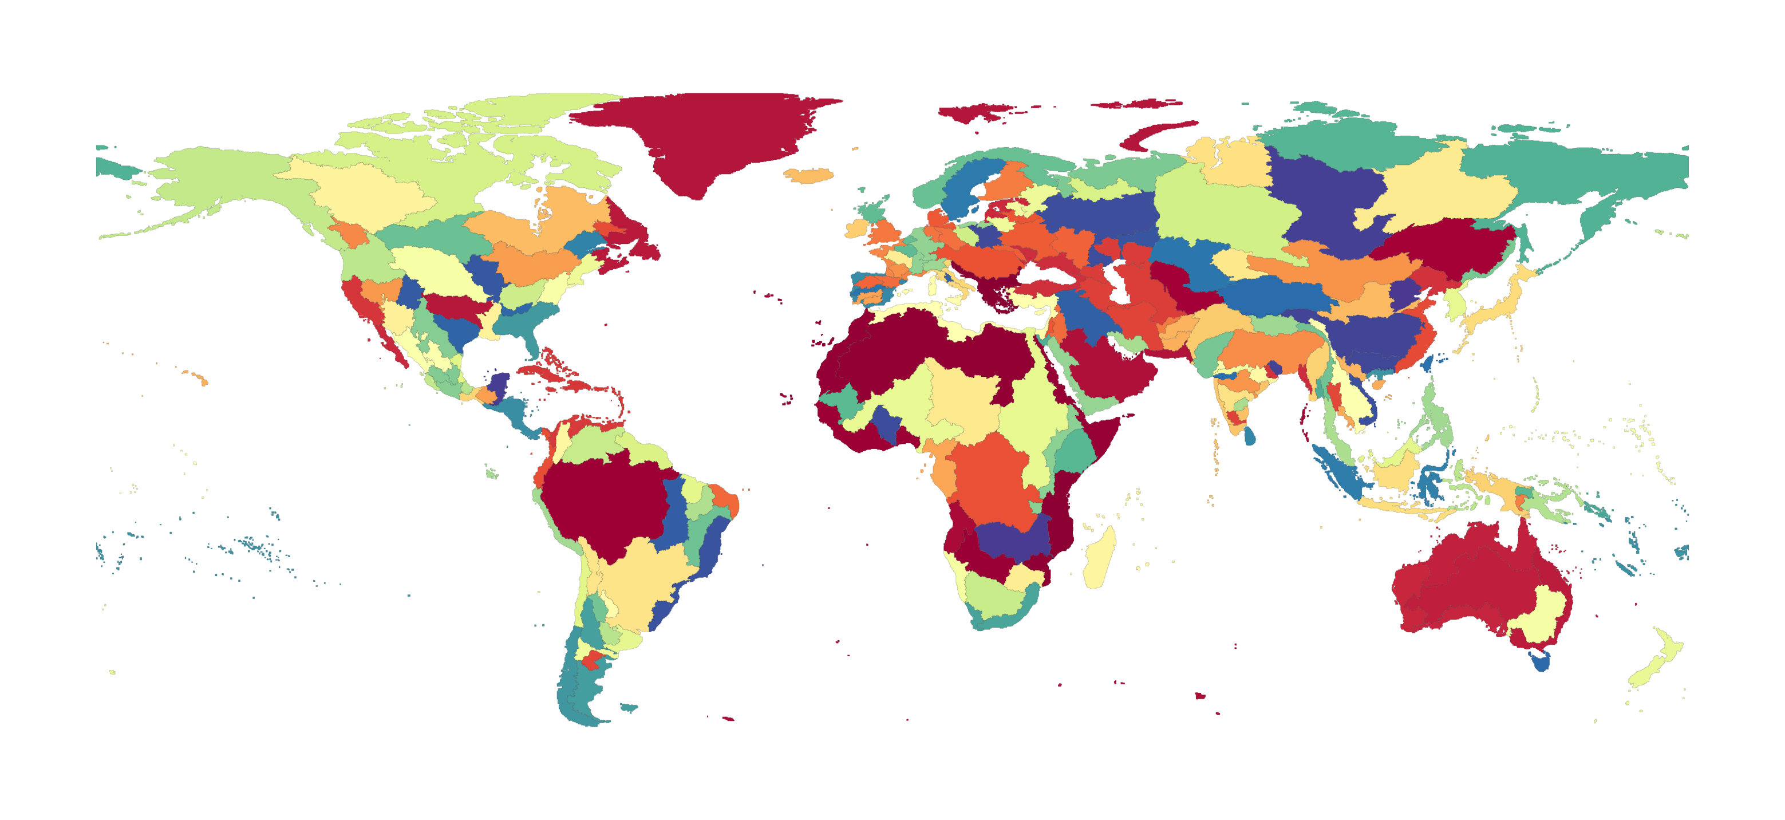
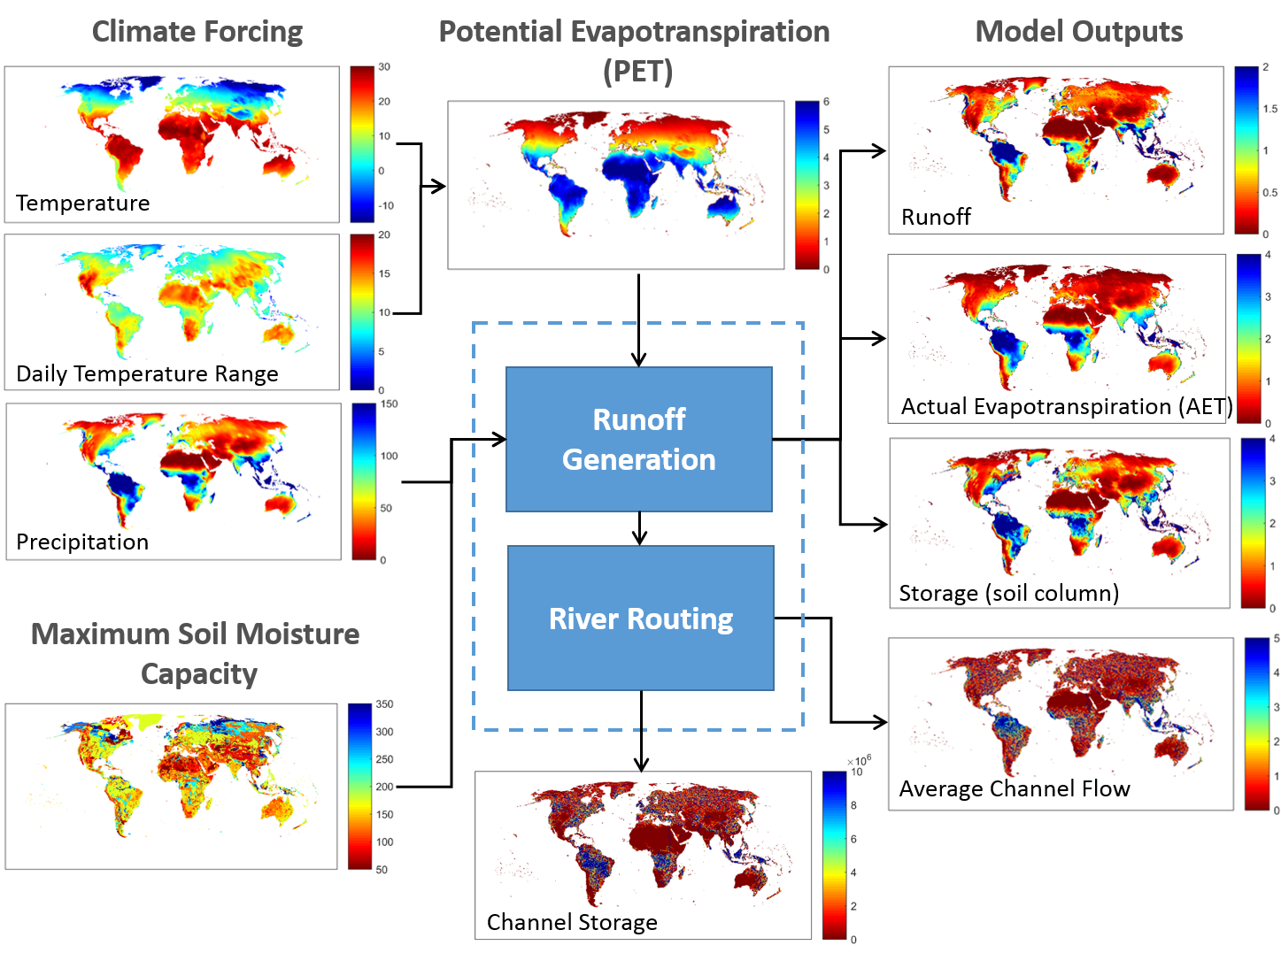
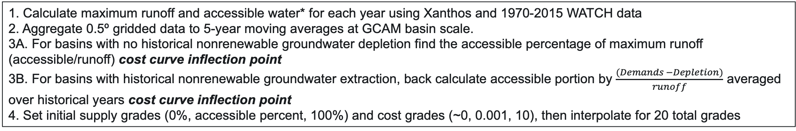
Surface Water Supply and Cost Curves in GCAM
Xanthos Processing
235 GCAM Basins
Price $
Price $
Availability [%]
Availability [%]
1. Calculate maximum runoff and accessible water* for each year using Xanthos and 1970-2015 WATCH data
2. Aggregate 0.5º gridded data to 5-year moving averages at GCAM basin scale.
3A. For basins with no historical nonrenewable groundwater depletion find the accessible percentage of maximum runoff (accessible/runoff) cost curve inflection point
3B. For basins with historical nonrenewable groundwater extraction, back calculate accessible portion by $\frac{(Demands −Depletion)}{runoff}$ averaged over historical years cost curve inflection point
4. Set initial supply grades (0%, accessible percent, 100%) and cost grades (~0, 0.001, 10), then interpolate for 20 total grades

Slide 48
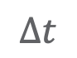
Groundwater Supply and Cost Curves in GCAM
Superwell
Derived unit cost of groundwater extraction over time at 50km grid cells
Estimates of groundwater availability from previous studies on porosity, depth-to-groundwater, and aquifer thickness in addition to WHYMAP
Constrained to only allow for 25% use of all physical water estimated in aquifer
Calculations within require an assumption of confined aquifer, however results assumed to be from unconfined aquifer
Increasing Depth
Price $
$$∆t$$
Cost Grade
Aggregate unit costs from Superwell 50km grid to GCAM basin scale and transform into 24 unique cost grades
Historical groundwater depletion from WaterGap is placed into grade_hist which is pulled during historical calibration
Added to GCAM as a subresource with price interactions with renewable water cost curves.

Slide 49
Surface Water and Groundwater Price Interaction
Renewable Cost Curve
Basin A
Groundwater Cost Curve
Basin A
Water withdrawals come from cheap renewable sources first.
If demands exceed the accessible portion in any given timestep, a price interaction between groundwater and renewable water occurs where water is drawn from the cheaper source first.
Price $
Price $
Availability [%]
Cost Grade
Price $
Price $
Availability [%]
Cost Grade

Slide 50
Surface Water and Groundwater Price Interaction
Renewable cost curve
Basin A
Groundwater cost curve
Basin A
Water withdrawals come from cheap renewable sources first.
If demands exceed the accessible portion in any given timestep, a price interaction between groundwater and renewable water occurs where water is drawn from the cheaper source first.
As groundwater is exhausted in low-cost grades, the point of interaction between renewable and groundwater is pushed to higher prices
More water than is deemed accessible must be pulled in order to start the price interaction with groundwater
Price $
Price $
Availability [%]
Cost Grade
Price $
Price $
Availability [%]
Cost Grade

Slide 51
Water Demand in GCAM

Slide 52
Understanding the Types Water Demand in GCAM
Water Withdrawals: water diverted or withdrawn from a surface water or groundwater source.
Water Consumption: water use that permanently withdraws water from its source; water that is no longer available because it has evaporated, been transpired by plants, incorporated into products or crops, consumed by people or livestock, or otherwise removed from the immediate water environment.
Biophysical Water Consumption: total water required for crop evapo-transpiration; the sum of blue (runoff + groundwater) and green (soil moisture) water
Seawater: water from the oceans, including brackish estuaries, that is withdrawn for cooling thermo-electric power plants, used in primary energy production, or as an input for desalination.

Slide 53
Sectoral Water Demands in GCAM
Total Water Use
Non-Agricultural Water Use
Irrigation
Livestock
Agricultural Water Use
Domestic
Electricity Generation
Primary Energy
Manufacturing
Hydropower
Wind
PV
CSP
Geothermal
Nuclear
Biomass (+CCS)
Oil (+CCS)
Gas (+CCS)
Coal (+CCS)
Once-Through
Dry Cooling
Cooling Ponds
Wet Towers
Coal
Natural Gas
Conventional Oil
Unconventional Oil
Uranium
Corn
FiberCrop
FodderGrass
FodderHerb
Fruits
Legumes
MiscCrop
NutsSeeds
OilCrop
OilPalm
OtherGrain
Rice
RootTuber
Soybean
SugarCrop
Vegetables
Wheat
Biomas
Beef
Dairy
Pork
Poultry
SheepGoat

Slide 54
Sectoral Water Demand Coefficients
Domestic (see Hejazi et al., 2013 for more):
Historical withdrawal values sourced from FAO AQUASTAT which are asssumed to grow with population and GDP. Technological change also assumed.
Consumption coefficients derived from Shiklomanov 2000 and indicates only the water that is used by consumers in a way that it is not returned to the immediate water environment.
Electricity Generation (see Davies et al., 2013 & Kyle et al., 2013 for more):
Demand coefficients for five cooling types derived from Macknick et al., 2011. Cooling system options compete in a calibrated logit nest, similar to the competition between fuels within this sector with capital costs for cooling systems coming from NETL 2008

Slide 55
Sectoral Water Demand Coefficients
Primary Energy Mining (see Hejazi et al,. 2014 for more):
Bottom-up estimates of water demand per unit energy produced for each fuel type. Methodology uses values from Maheu 2009, less the fraction of seawater (Middle East 95%, all other regions 43% (Kenny et al., 2009).
Withdrawals are found as the consumption coefficient multiplied by an exogenous value of 3.3 (Solley et al., 1998).
Manufacturing:
Self-supplied surface and groundwater to industrial manufacturers. Sourced from FAO AQUASTAT. Excludes water for cooling.
Agriculture:
Green and Blue water footprints are derived from Mekonnen and Hoekstra 2011 by crop and region. Additionally, water losses and water use efficiencies in irrigation technologies are assumed to be regionally heteorgenous and are dervied from Rohwer et al. 2007.
Livestock:
No distinction between withdrawals and consumption. Includes animal drinking water, plus any other water used by the animal production operations. Dervived from Mekonnen and Hoekstra 2010 with animal stocks from FAO

Slide 56
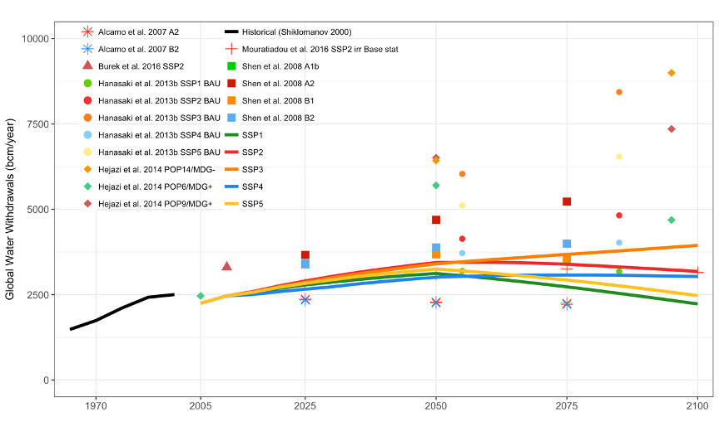
Recent Water Demand Results

Slide 57
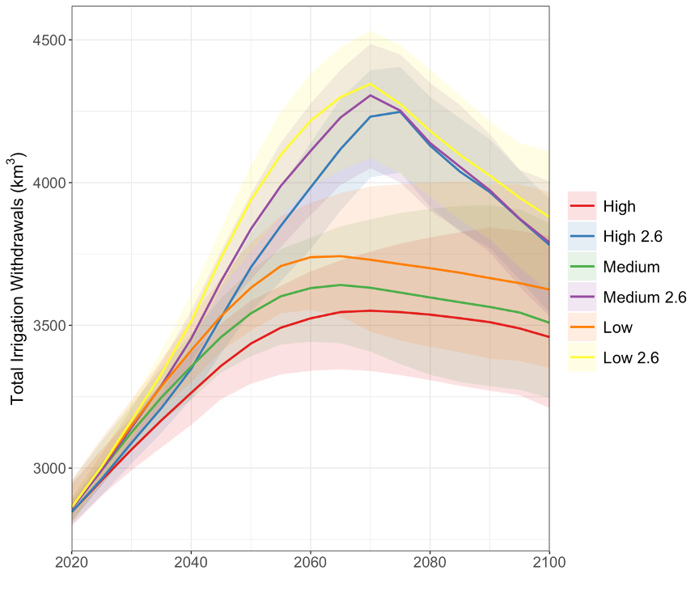
Recent Water Demand Results
Graham et al., 2023, One Earth

Slide 58
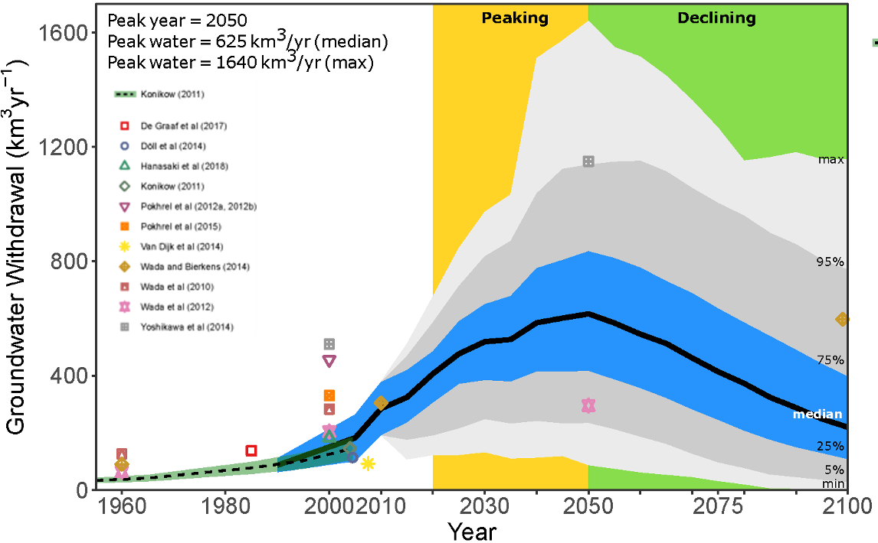
Recent Water Demand Results
Niazi et al., 2024, Nat. Sus.

Slide 59
The End

Slide 60
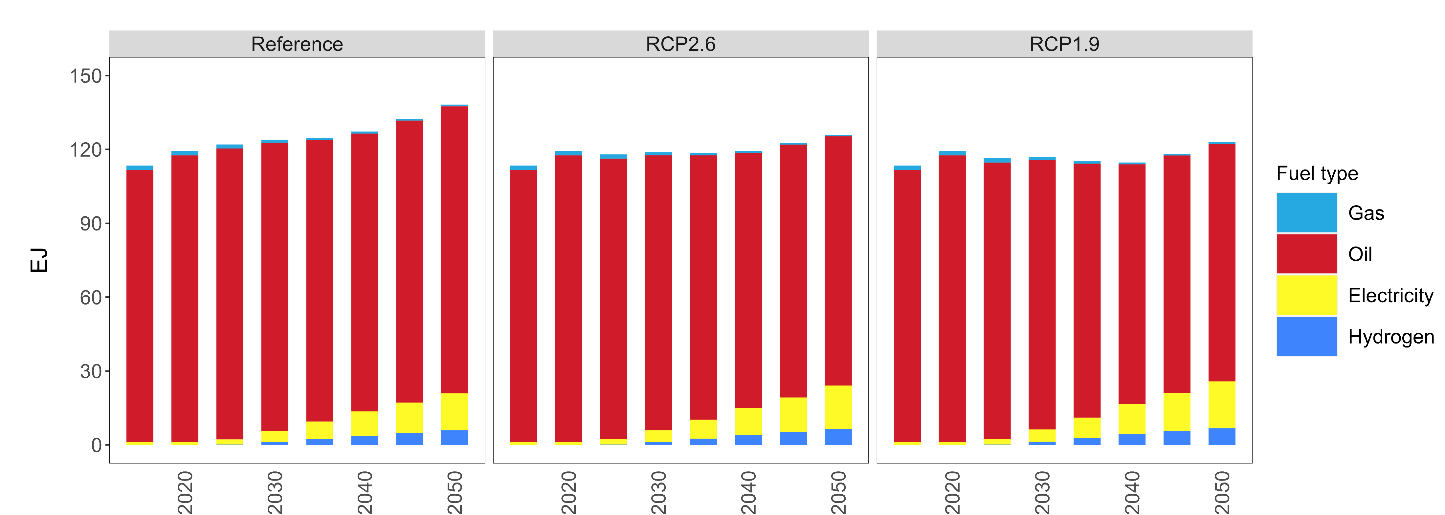
GCAM results from Reference, RCP 2.6. RCP 1.9: Transportation final energy

Slide 61
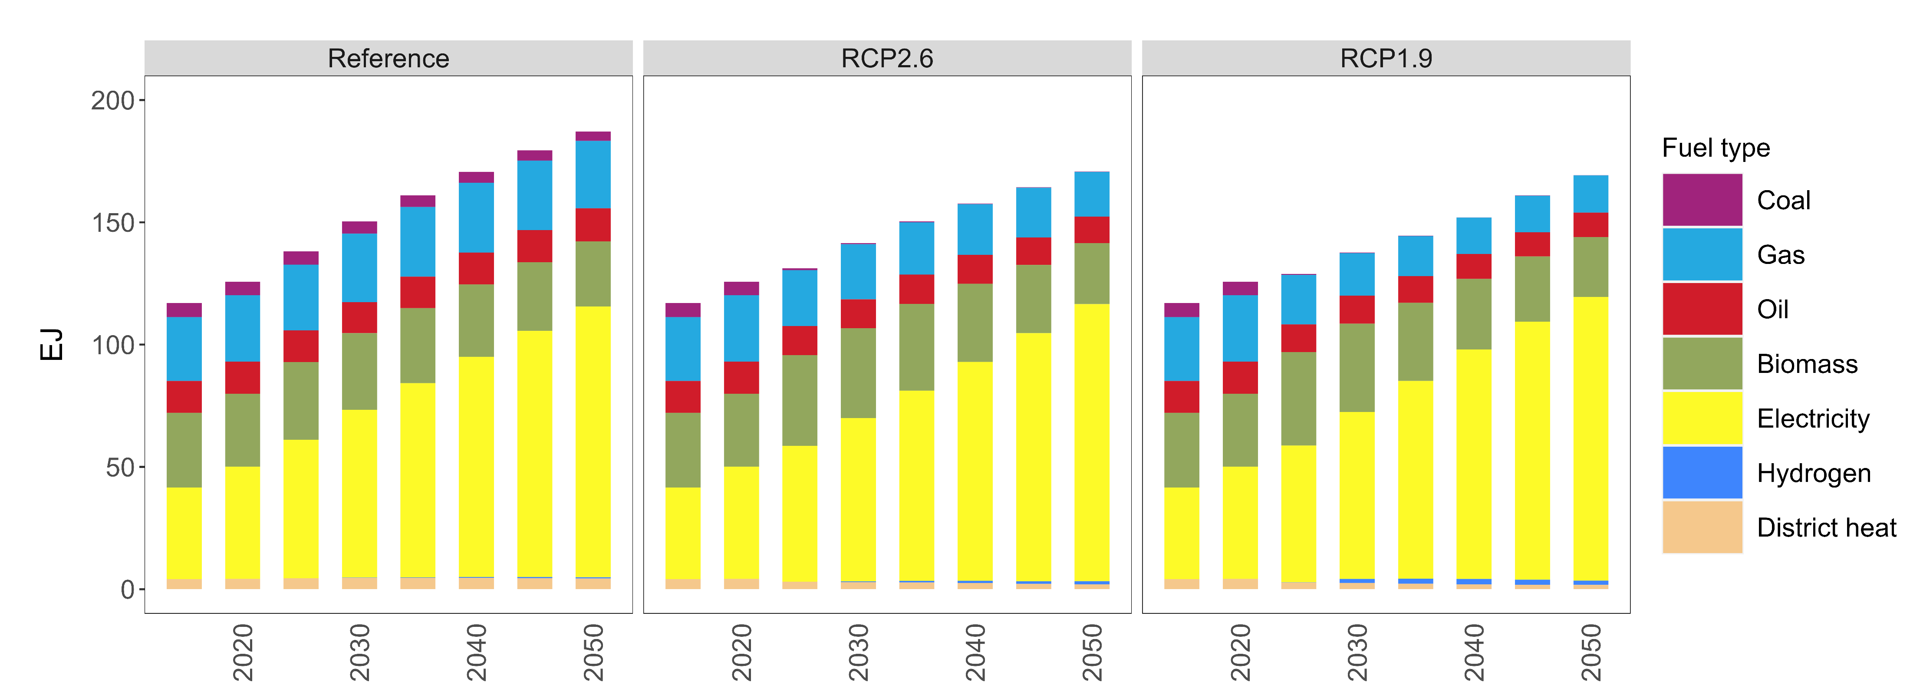
GCAM results from Reference, RCP 2.6. RCP 1.9: Buildings final energy

